Slide 1
Physical Security

Slide 2
Three Security Disciplines
Physical
  Most common security discipline
  Protect facilities and contents
    Plants, labs, stores, parking areas, loading areas, warehouses, offices, equipment, machines, tools, vehicles, products, materials
Personnel
  Protect employees, customers, guests
Information
  The rest of this course

Slide 3

Information Revolution
Information Revolution as pervasive at the Industrial Revolution
Impact is Political, Economic, and Social as well as Technical
Information has an increasing intrinsic value
Protection of critical information now a critical concern in Government, Business, Academia

Slide 4
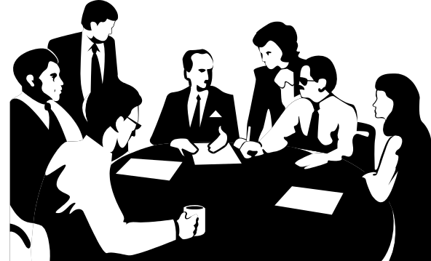
Politics and Technology
The end of the Cold War resulted in a greater political complexity
Information critical to all aspects of government
    Military
    Commerce
    Politics
  Information is Power
  Protection of information more important than ever

Slide 5
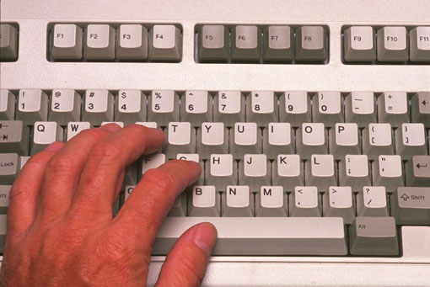
Business and Technology
Information has become a product on its own
Information technologies critical
Protection of information essential
Business now dependent on the Net
Who controls the ON/OFF Switch?

Slide 6
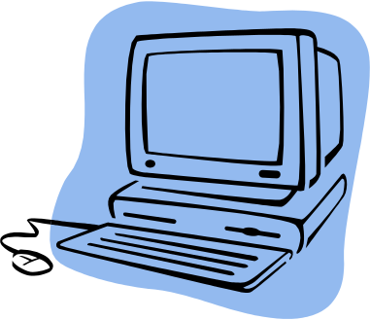
The New World
The Internet allows global connectivity
Cyber-space has no borders
Anonymity easy to accomplish
New breed of threat
    Technically smart
    Determined, knowledgeable
Physical Security often overlooked in the new threat environment

Slide 7

Nature of the Threat
Threat environment changes
Nation-state threat
  Countries see computers as equalizers
  New balance of power through information control
Non-state actors
  New levels of potential threat
  “Strategic Guns for Hire”
  Terrorism remains physical act
Physical attacks against information sources requires minimal effort for maximum effect - Gums up the Gears!!!!

Slide 8
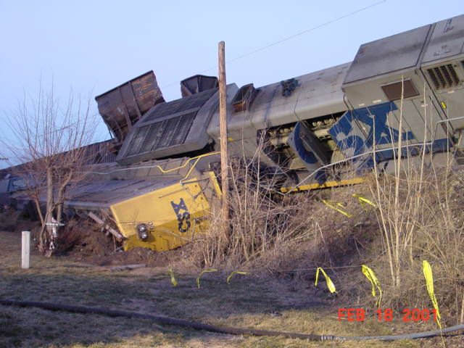

How Has It Changed?
Physical Events Have Cyber Consequences
Cyber Events Have Physical Consequences

Slide 9

Threat and Physical Security
Physical Attacks require little resources
Insider threat very real
    Disgruntled employee
    Agent for hire
Tactics well known
and hard to stop
    World Trade Center
    Aldrich Aimes
Financial network facilities viable target
Target information readily available

Slide 10

Why Physical Security?
Not all threats are “cyber threats”
Information one commodity that can be stolen without being “taken”
Physically barring access is first line of defense
Forces those concerned to prioritize!
Physical Security can be a deterrent
Security reviews force insights into value of what is being protected

Slide 11
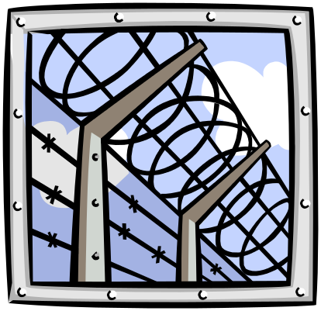
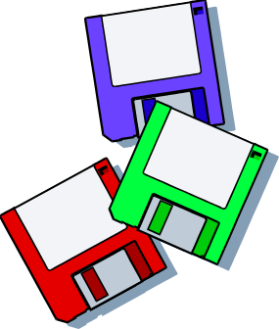

Layered Security
Physical Barriers
    Fences
    Alarms
    Restricted Access Technology
Physical Restrictions
    Air Gapping
    Removable Media
    Remote Storage
Personnel Security Practices
    Limited Access
    Training
    Consequences/Deterrence

Slide 12


Physical Barriers
Hardened Facilities
    Fences
    Guards
    Alarms
    Locks
    Restricted Access Technologies
      Biometrics
      Coded Entry
      Badging
    Signal Blocking (Faraday Cages)

Slide 13
Outer Protective Layers
Structure
  Fencing, gates, other barriers
Environment
  Lighting, signs, alarms
Purpose
  Define property line and discourage trespassing
  Provide distance from threats

Slide 14
Middle Protective Layers
Structure
  Door controls, window controls
  Ceiling penetration
  Ventilation ducts
  Elevator Penthouses
Environment
  Within defined perimeter, positive controls
Purpose
  Alert threat, segment protection zones

Slide 15
Inner Protective Layers
Several layers
Structure
  Door controls, biometrics
  Signs, alarms, cctv
  Safes, vaults
Environment
  Authorized personnel only
Purpose
  Establish controlled areas and rooms

Slide 16
Example System: SEI
Building Structure:
  6 exterior doors
  Windows secured
  Exterior Lit
Middle Layers:
  Guard desk
  Proximity card system
  CCTV
Inner Layers: Intellectual Property Protection

Slide 17
Other Barrier Issues
Handling of trash or scrap
Fire:
  Temperature
  Smoke
Pollution:
  CO
  Radon
Flood
Earthquake

Slide 18

Physical Restrictions
Air Gapping Data
    Limits access to various security levels
    Requires conscious effort to violate
    Protects against inadvertent transmission
Removable Media
    Removable Hard Drives
    Floppy Disks/CDs/ZIP Disks
Remote Storage of Data
    Physically separate storage facility
    Use of Storage Media or Stand Alone computers
    Updating of Stored Data and regular inventory

Slide 19

Personnel Security Practices
Insider Threat the most serious
    Disgruntled employee
    Former employee
    Agent for hire
Personnel Training
    Critical Element
    Most often overlooked
Background checks
    Critical when access to information required
    Must be updated
    CIA/FBI embarrassed

Slide 20

People
Disgruntled employee / former employee
Moonlighter
Marketing, sales representatives, etc.
Purchasing agents, buyers, subcontract administrators
Consultants
Vendor/Subcontractor
Clerical
Applicants, Visitors, Customers

Slide 21
Activities or Events
Publications, public releases, etc.
Seminars, conventions or trade shows
Survey or questionnaire
Plant tours, “open house”, family visits
Governmental actions: certification, investigation
Construction and Repair

Slide 22
Technical Security
Alarms
    Loud and Noisy
    Silent
    Integrated into barrier methods
Video/Audio
    Deterrent factor
    Difficult to archive
Bio-Metrics
    Identification
    Reliability questions

Slide 23
NISPOM
National Industrial Security Operating Manual
Prescribes requirements, restrictions and other safeguards that are necessary to prevent unauthorized disclosure of information
Protections for special classes of information: Restricted Information, Special Access Program Information, Sensitive Compartmented Information
National Security Council provides overall policy direction
Governs oversight and compliance for 20 government agencies

Slide 24

The Place of Physical Security
Physical Security is part of integrated security plan
Often overlooked when considering Information Security
No information security plan is complete without it!

